Slide 1
Knapsack Problem
Greedy Approach

Slide 2
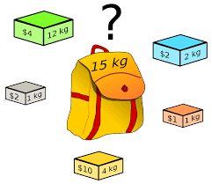
Knapsack Problem
The knapsack problem states that given a set of items, holding weights and profit values, one must determine the subset of the items to be added in a knapsack such that, the total weight of the items must not exceed the limit of the knapsack and its total profit value is maximum.
Types of Knapsack problem
Fractional Knapsack
0/1 Knapsack

Slide 3
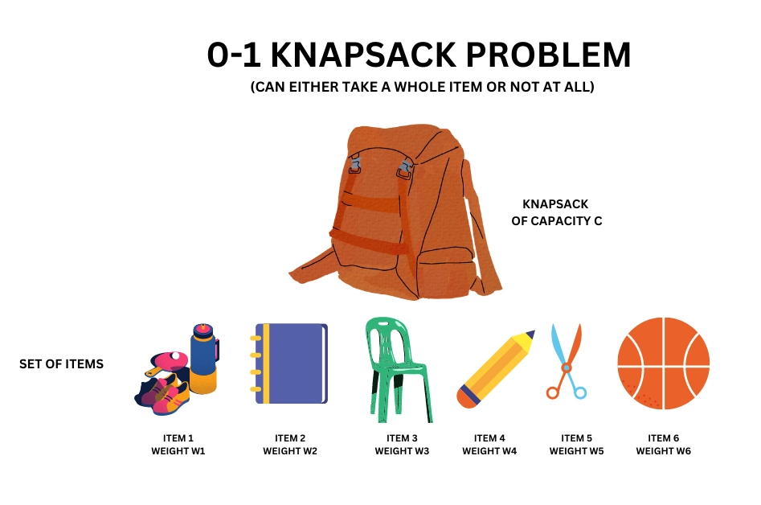
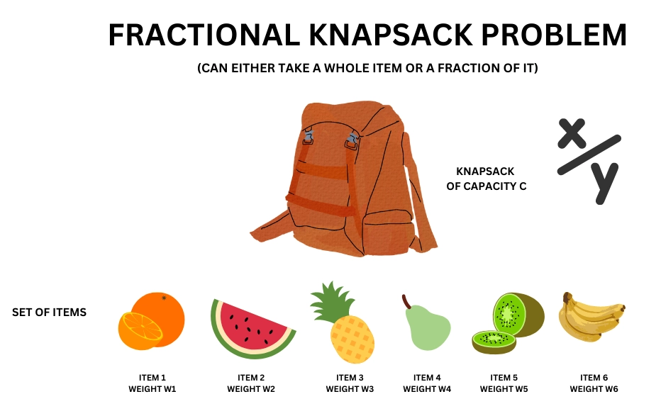
Fractional Knapsack
0/1 Knapsack
In fractional knapsack, the items are broken to maximize the profit. The problem in which we break the item is known as a Fractional knapsack problem.
In 0/1 knapsack, the constraint here is we can either put an item completely into the bag or cannot put it at all [It is not possible to put a part of an item into the bag.

Slide 4
Features considered in the Greedy Algorithm to maximize the profit
There are basically three approaches to solve the problem:
The first approach is to select the item based on the maximum profit.
The second approach is to select the item based on the minimum weight.
The third approach is to calculate the ratio of profit/weight.

Slide 5
Select the item based on the maximum profit
Weight of the Knapsack: 15
Object | Weight | Profit
1 | 1 | 10
2 | 3 | 15
3 | 5 | 7
4 | 4 | 8
5 | 1 | 9
6 | 3 | 4
7 | 2 | 5
Fractional Knapsack
Object | Weight | Profit
2 | 3 | 15
1 | 1 | 10
5 | 1 | 9
4 | 4 | 8
3 | 5 | 7
7 | 2 | 5
6 | 3 | 4
Object | Weight | Profit | Remaining Weight
2 | 3 | 15 | 12
1 | 1 | 10 | 11
5 | 1 | 9 | 10
4 | 4 | 8 | 6
3 | 5 | 7 | 1
7 | 2 | 5 | 1
6 | 3 | 4 | 0
Arrange as per Profit
Profit =15+10+9+8+7+(5/2)
= 51.5

Slide 6
Weight of the Knapsack: 15
Object | Weight | Profit
1 | 1 | 10
2 | 3 | 15
3 | 5 | 7
4 | 4 | 8
5 | 1 | 9
6 | 3 | 4
7 | 2 | 5
Fractional Knapsack
Object | Weight | Profit
1 | 1 | 10
5 | 1 | 9
7 | 2 | 5
2 | 3 | 15
6 | 3 | 4
4 | 4 | 8
3 | 5 | 7
Object | Weight | Profit | Remaining Weight
1 | 1 | 10 | 14
5 | 1 | 9 | 13
7 | 2 | 5 | 11
2 | 3 | 15 | 8
6 | 3 | 4 | 5
4 | 4 | 8 | 1
3 | 5 | 7 | 1
Arrange as per weight
Select the item based on the minimum weight
Profit =10+9+5+15+4+8+(7/5)
= 52.4

Slide 7
Fractional Knapsack
Weight of the Knapsack: 15
Object | Weight | Profit
1 | 1 | 10
2 | 3 | 15
3 | 5 | 7
4 | 4 | 8
5 | 1 | 9
6 | 3 | 4
7 | 2 | 5
Object | Weight | Profit | Profit / Weight
1 | 1 | 10 | 10.00
5 | 1 | 9 | 9.00
2 | 3 | 15 | 5.00
7 | 2 | 5 | 2.50
4 | 4 | 8 | 2.00
3 | 5 | 7 | 1.40
6 | 3 | 4 | 1.33
Object | Weight | Profit | Profit / Weight | Remaining Weight
1 | 1 | 10 | 10.00 | 14
5 | 1 | 9 | 9.00 | 13
2 | 3 | 15 | 5.00 | 10
7 | 2 | 5 | 2.50 | 8
4 | 4 | 8 | 2.00 | 4
3 | 5 | 7 | 1.40 | 4
6 | 3 | 4 | 1.33
Arrange as per Profit / Weight
Profit =10+9+15+5+8+(1.40*4)
= 52.6
Select the item based on the maximum Profit / Weight

Slide 8
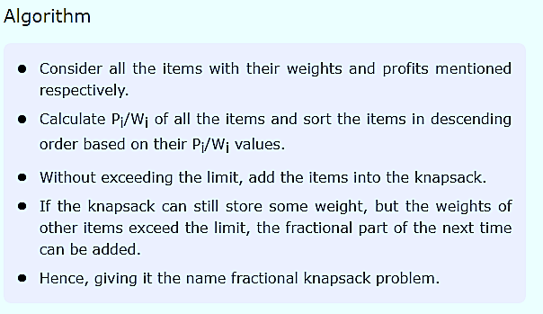
Algorithm for Knapsack problem through Greedy Approach

Slide 9
Time complexity of Knapsack problem using Greedy approach
Time Complexity: O( N*Log N), where N is the number of items given. Finding the ratio and sorting them in the descending order using merge sort, has the overall time complexity of O(N* Log N).

